Slide 1
MAL1, Session 9
Convolutional Neural Networks

Slide 2
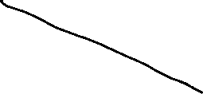

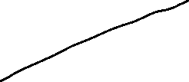

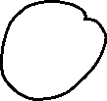
The Perceptron

Slide 3
Stochastic Gradient Descent
Don't adjust after each sample
Too indecisive - diverges
Possible: Run all samples (an epoch) and adjust by the average
Converges too slowly
Stochastic gradient descent: In each epoch,
Divide samples into random batches
Run each batch
Adjust by average after each batch

Slide 4
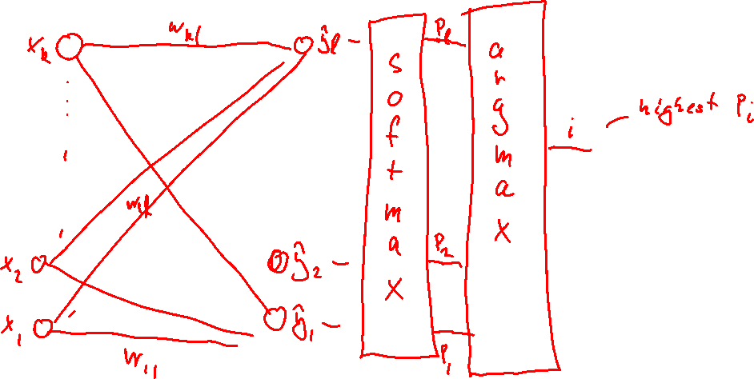
Non-binary output

Slide 5
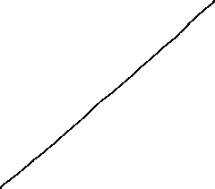

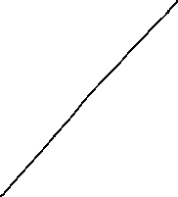
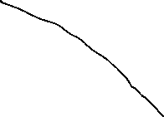


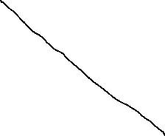
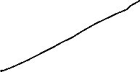

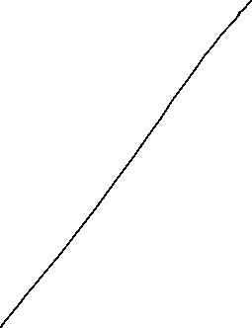


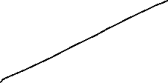


Multi-layer neural networks

Slide 6
Vanishing gradients
Gradients get smaller by layer
(but sometimes larger - exploding gradients)
Low gradient, low adjustment => network cannot converge
Solutions:
Other activation functions: tanh, ReLU, Swish
Other optimization algorithms: Adam, AdamW, Nestorov
Other initialization schemes: HeNormal, HeUniform, …
Normalize before each layer: Batch normalization

Slide 7
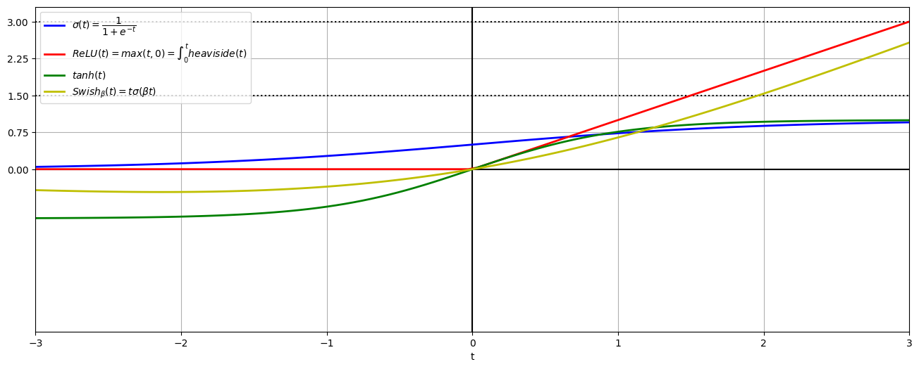
Activation functions

Slide 8
Regularization
Lasso (L1) and Ridge(L2) still work.
Dropout:
During a training step a percent (hyperparameter: rate) of neurons become inactive (output 0)
The rest of the neurons get an equivalent boost to their output: 1/(1-rate)
The idea is that to pick up the slack, the neurons will have to be less specialized
It works surprisingly well

Slide 9
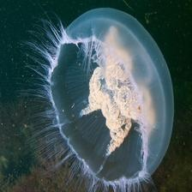
Image recognition
Treating every pixel as "just a dimension" loses too much information
This image is not a 16,384-dimensional vector
It's a 32x32 2nd-rank tensor
How can we use that?
First idea: Use a small rectangle of the image to feed a single neuron

Slide 10
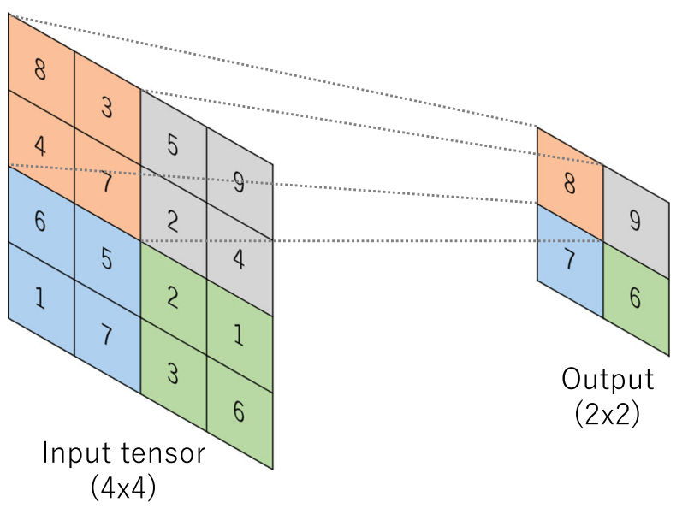
Adding position to neural networks

Slide 11
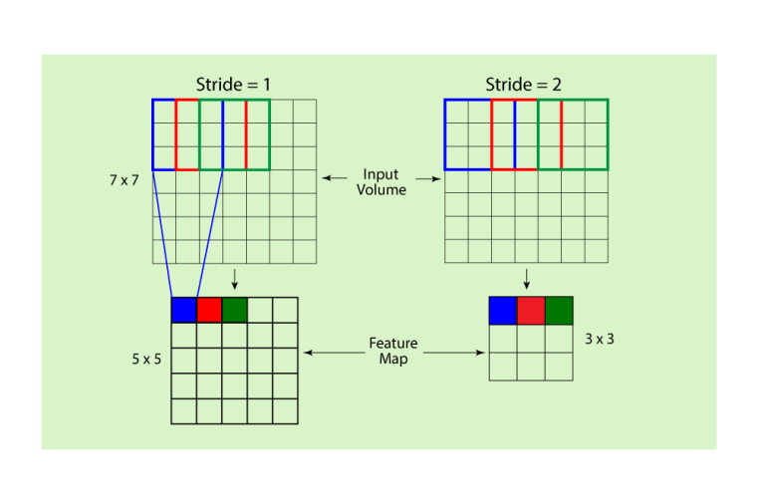
Stride

Slide 12
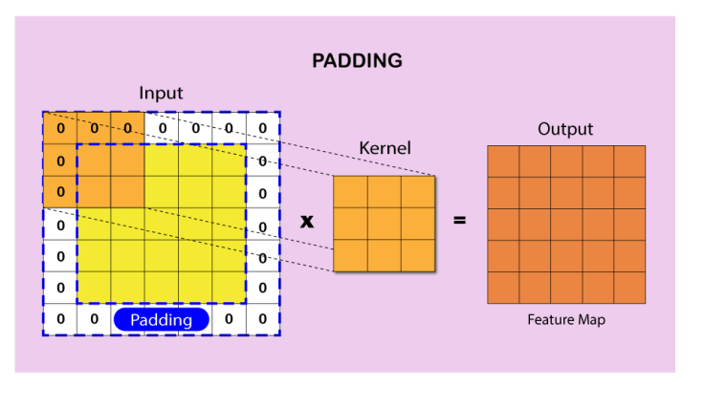
Padding

Slide 13
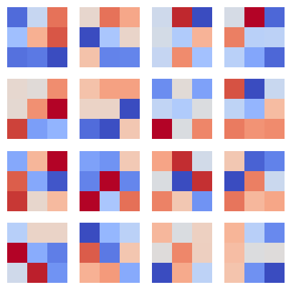
Kernel
(It's not an SVM kernel)
These are kernels of size 3
Red: positive weight
Blue: negative weight
Second idea: Use same kernel for the entire image
Extracts a feature map of the image
Third idea: Use many kernels to extract many feature maps

Slide 14
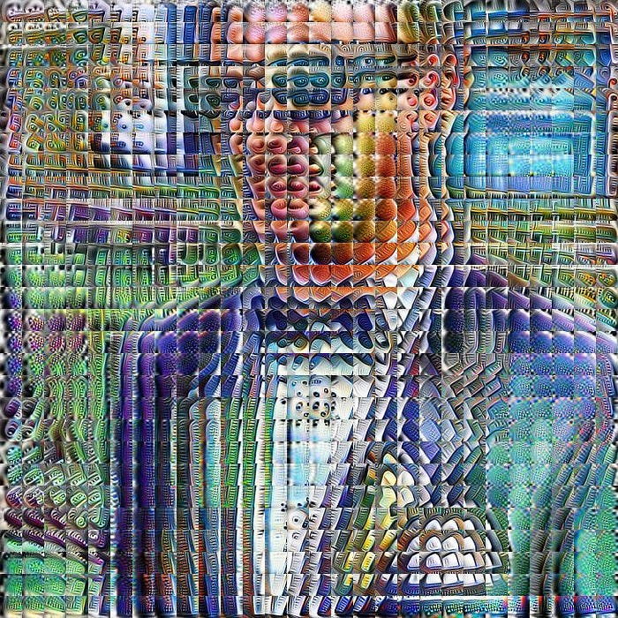
Feature maps
Feature maps enhances certain parts of the image
The weights are learnable, so we can't be sure it's understandable
Example:
Input: RGB image size 128x128
shape: 128x128x3
16 kernels size 5
Output shape: 5x5x16
Fourth idea: Deep convolutional networks
feed result into new convolutional layer

Slide 15
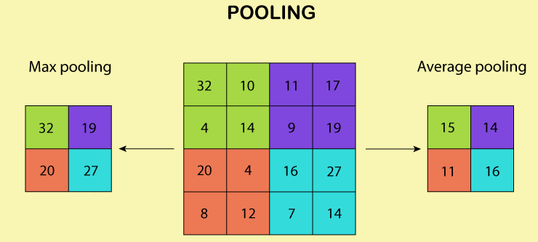
Subsampling

Slide 16
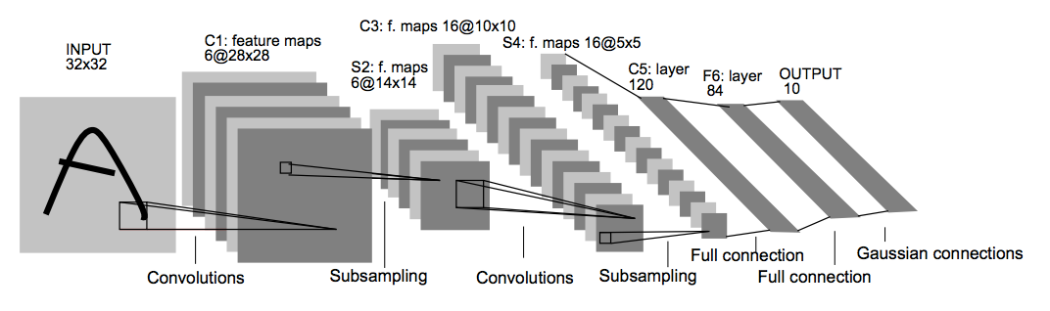
LeNet-5

Slide 17
Examples
MNIST (CNN)
Jellyfish

Slide 18
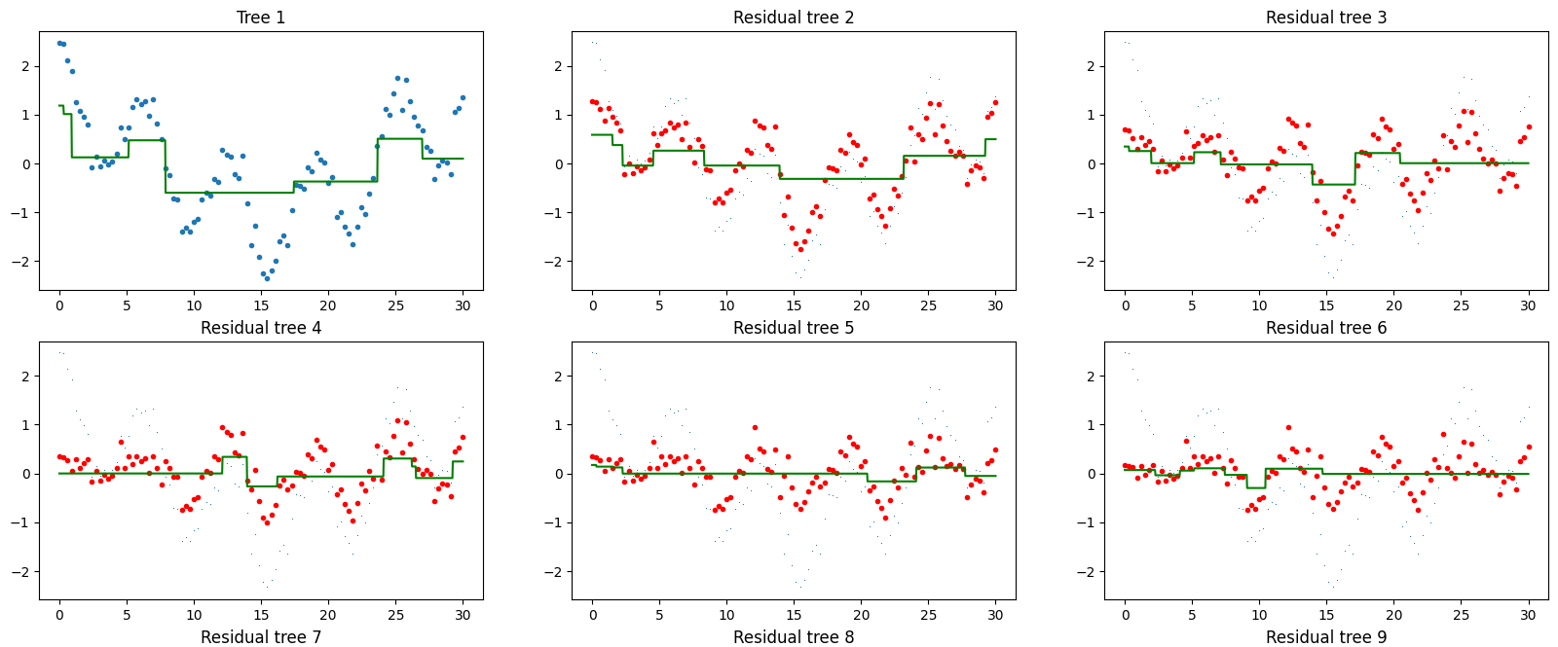
Remember residuals?

Slide 19
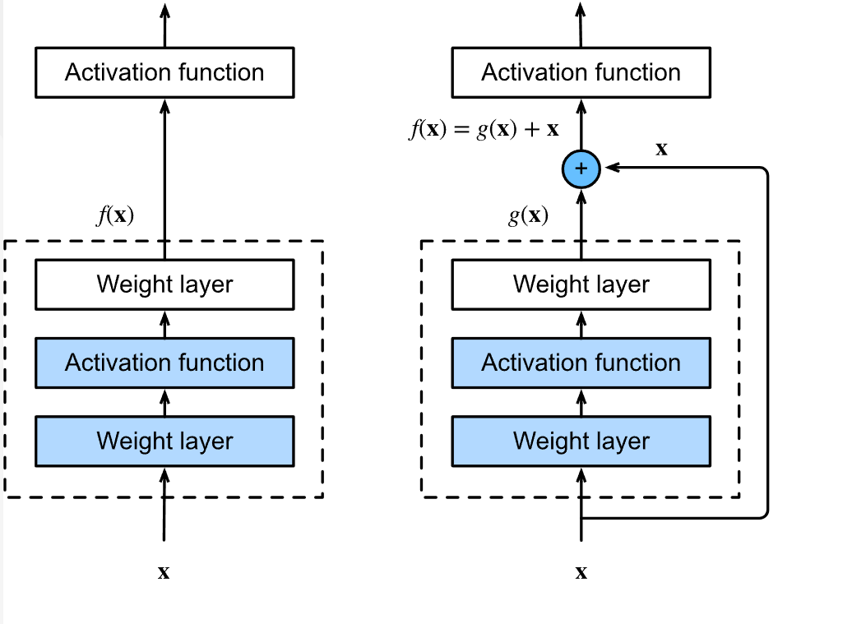
Residual convolutional neural network

Slide 20
Creating a residual unit in Keras (I)
class ResidualUnit(tf.keras.layers.Layer):
def __init__(self, filters, kernel_size, strides=1, activation="swish", **kwargs):
super().__init__(**kwargs)
self.activation = tf.keras.activations.get(activation)
self.main_path = tf.keras.models.Sequential([
layers.Conv2D(filters, kernel_size, strides=strides),
tf.keras.layers.BatchNormalization(),
layers.Activation(self.activation),
layers.Conv2D(filters, kernel_size, strides=1),
tf.keras.layers.BatchNormalization()
])
self.skip_path = lambda Z: Z
if strides > 1:
self.skip_path = tf.keras.models.Sequential([
layers.Conv2D(filters, 1, strides=strides),
tf.keras.layers.BatchNormalization()
])

Slide 21
Creating a residual unit in Keras (II)
class ResidualUnit(tf.keras.layers.Layer):
# Constructor goes here
def call(self, inputs):
Z = self.main_path(inputs)
skip_Z = self.skip_path(inputs)
return self.activation(Z + skip_Z)

Slide 22
Why residual units?
Deep convolutional networks tend to suffer from vanishing gradients - regardless of the activation function
In fact, there is evidence that convolutional networks perform worse as they get deeper
By constantly adding the inputs to the output, you get a way to back propagate errors to the lowest layer

Slide 23
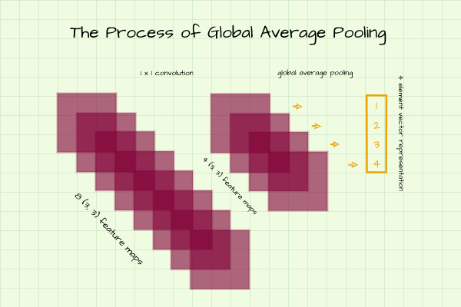
Global Average Pooling
At the end of a long sequence of convolutional network we end up with many small feature maps
They no longer contain spatial information - they are more like a neuron
A Global Average Pooling layer extracts the average of each feature map and feeds it into a neuron

Slide 24
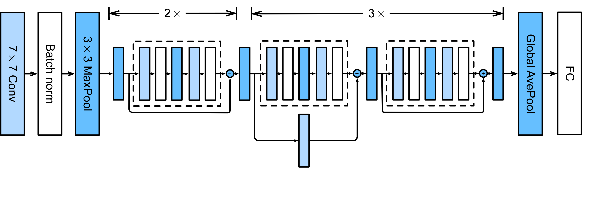
ResNet-18

Slide 25
Reusing networks

Slide 26
Examples
jellyfish-residual
jellyfish-resnet

